Slide 1
LECTURE 6:
MULTIAGENT INTERACTIONS
An Introduction to MultiAgent Systems
http://www.csc.liv.ac.uk/~mjw/pubs/imas

Slide 2
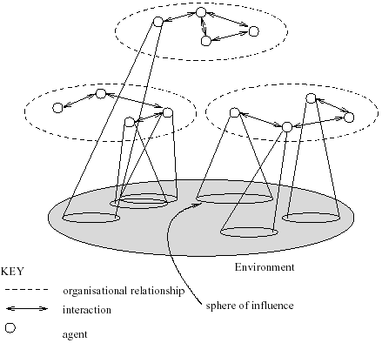
What are Multiagent Systems?

Slide 3
MultiAgent Systems
Thus a multiagent system contains a number of agents…
…which interact through communication…
…are able to act in an environment…
…have different “spheres of influence” (which may coincide)…
…will be linked by other (organizational) relationships

Slide 4
Utilities and Preferences
Assume we have just two agents: Ag = {i, j}
Agents are assumed to be self-interested: they have preferences over how the environment is
Assume Ω = {ω₁, ω₂, …}is the set of “outcomes” that agents have preferences over
We capture preferences by utility functions:
u_{i} = Ω → 
u_{j} = Ω → 
Utility functions lead to preference orderings over outcomes:
ω š_{i} ω’ means u_{i}(ω)  u_{i}(ω’)
ω ™_{i} ω’ means u_{i}(ω) > u_{i}(ω’)

Slide 5
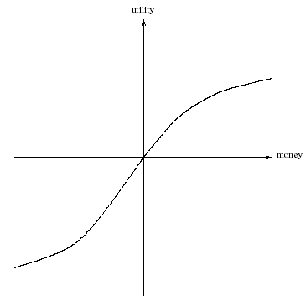
What is Utility?
Utility is not money (but it is a useful analogy)
Typical relationship between utility & money:

Slide 6

Multiagent Encounters
We need a model of the environment in which these agents will act…
  agents simultaneously choose an action to perform, and as a result of the actions they select, an outcome in Ω will result
  the actual outcome depends on the combination of actions
  assume each agent has just two possible actions that it can perform, C (“cooperate”) and D (“defect”)
Environment behavior given by state transformer function:

Slide 7
Multiagent Encounters
Here is a state transformer function:
(This environment is sensitive to actions of both agents.)
Here is another:
(Neither agent has any influence in this environment.)
And here is another:
(This environment is controlled by j.)

Slide 8


Rational Action
Suppose we have the case where both agents can influence the outcome, and they have utility functions as follows:
With a bit of abuse of notation:
Then agent i’s preferences are:
“C” is the rational choice for i.
(Because i prefers all outcomes that arise through C over all outcomes that arise through D.)

Slide 9
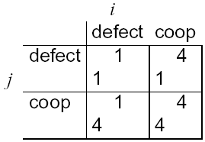
Payoff Matrices
We can characterize the previous scenario in a payoff matrix:
Agent i is the column player
Agent j is the row player

Slide 10
Dominant Strategies
Given any particular strategy (either C or D) of agent i, there will be a number of possible outcomes
We say s₁ dominates s₂ if every outcome possible by i playing s₁ is preferred over every outcome possible by i playing s₂
A rational agent will never play a dominated strategy
So in deciding what to do, we can delete dominated strategies
Unfortunately, there isn’t always a unique undominated strategy

Slide 11
Nash Equilibrium
In general, we will say that two strategies s₁ and s₂ are in Nash equilibrium if:
  under the assumption that agent i plays s₁, agent j can do no better than play s₂; and
  under the assumption that agent j plays s₂, agent i can do no better than play s₁.
Neither agent has any incentive to deviate from a Nash equilibrium
Unfortunately:
  Not every interaction scenario has a Nash equilibrium
  Some interaction scenarios have more than one Nash equilibrium

Slide 12
Competitive and Zero-Sum Interactions
Where preferences of agents are diametrically opposed we have strictly competitive scenarios
Zero-sum encounters are those where utilities sum to zero:
u_{i}(ω) + u_{j}(ω) = 0 for all ω  Ω
Zero sum implies strictly competitive
Zero sum encounters in real life are very rare … but people tend to act in many scenarios as if they were zero sum

Slide 13
The Prisoner’s Dilemma
Two men are collectively charged with a crime and held in separate cells, with no way of meeting or communicating. They are told that:
  if one confesses and the other does not, the confessor will be freed, and the other will be jailed for three years
  if both confess, then each will be jailed for two years
Both prisoners know that if neither confesses, then they will each be jailed for one year

Slide 14
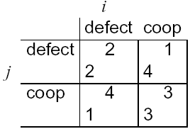
The Prisoner’s Dilemma
Payoff matrix for
prisoner’s dilemma:
Top left: If both defect, then both get punishment for mutual defection
Top right: If i cooperates and j defects, i gets sucker’s payoff of 1, while j gets 4
Bottom left: If j cooperates and i defects, j gets sucker’s payoff of 1, while i gets 4
Bottom right: Reward for mutual cooperation

Slide 15
The Prisoner’s Dilemma
The individual rational action is defect
This guarantees a payoff of no worse than 2, whereas cooperating guarantees a payoff of at most 1
So defection is the best response to all possible strategies: both agents defect, and get payoff = 2
But intuition says this is not the best outcome:
Surely they should both cooperate and each get payoff of 3!

Slide 16
The Prisoner’s Dilemma
This apparent paradox is the fundamental problem of multi-agent interactions.
It appears to imply that cooperation will not occur in societies of self-interested agents.
Real world examples:
  nuclear arms reduction (“why don’t I keep mine. . . ”)
  free rider systems — public transport;
  in the UK — television licenses.
The prisoner’s dilemma is ubiquitous.
Can we recover cooperation?

Slide 17
Arguments for Recovering Cooperation
Conclusions that some have drawn from this analysis:
  the game theory notion of rational action is wrong!
  somehow the dilemma is being formulated wrongly
Arguments to recover cooperation:
  We are not all Machiavelli!
  The other prisoner is my twin!
  The shadow of the future…

Slide 18
The Iterated Prisoner’s Dilemma
One answer: play the game more than once
If you know you will be meeting your opponent again, then the incentive to defect appears to evaporate
Cooperation is the rational choice in the infinititely repeated prisoner’s dilemma
(Hurrah!)

Slide 19
Backwards Induction
But…suppose you both know that you will play the game exactly n times
On round n - 1, you have an incentive to defect, to gain that extra bit of payoff…
But this makes round n – 2 the last “real”, and so you have an incentive to defect there, too.
This is the backwards induction problem.
Playing the prisoner’s dilemma with a fixed, finite, pre-determined, commonly known number of rounds, defection is the best strategy

Slide 20
Axelrod’s Tournament
Suppose you play iterated prisoner’s dilemma against a range of opponents…
What strategy should you choose, so as to maximize your overall payoff?
Axelrod (1984) investigated this problem, with a computer tournament for programs playing the prisoner’s dilemma

Slide 21
Strategies in Axelrod’s Tournament
ALLD:
  “Always defect” — the hawk strategy;
TIT-FOR-TAT:
  On round u = 0, cooperate
  On round u > 0, do what your opponent did on round u – 1
TESTER:
  On 1st round, defect. If the opponent retaliated, then play TIT-FOR-TAT. Otherwise intersperse cooperation and defection.
JOSS:
  As TIT-FOR-TAT, except periodically defect

Slide 22
Recipes for Success in Axelrod’s Tournament
Axelrod suggests the following rules for succeeding in his tournament:
  Don’t be envious:
  Don’t play as if it were zero sum!
  Be nice:
  Start by cooperating, and reciprocate cooperation
  Retaliate appropriately:
  Always punish defection immediately, but use “measured” force — don’t overdo it
  Don’t hold grudges:
  Always reciprocate cooperation immediately

Slide 23
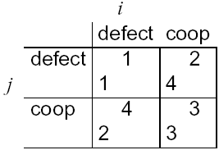
Game of Chicken
Consider another type of encounter — the game of chicken:
(Think of James Dean in Rebel without a Cause: swerving = coop, driving straight = defect.)
Difference to prisoner’s dilemma:
Mutual defection is most feared outcome.
(Whereas sucker’s payoff is most feared in prisoner’s dilemma.)
Strategies (c,d) and (d,c) are in Nash equilibrium

Slide 24
Other Symmetric 2 x 2 Games
Given the 4 possible outcomes of (symmetric) cooperate/defect games, there are 24 possible orderings on outcomes
  CC š_{i} CD š_{i} DC š_{i} DD
  Cooperation dominates
  DC š_{i} DD š_{i} CC š_{i} CD
  Deadlock. You will always do best by defecting
  DC š_{i} CC š_{i} DD š_{i} CD
  Prisoner’s dilemma
  DC š_{i} CC š_{i} CD š_{i} DD
  Chicken
  CC š_{i} DC š_{i} DD š_{i} CD
  Stag hunt

